Slide 1
XML
eXtensible Markup Language

Slide 2
What is XML?
XML is designed to store and transport data.
It was created to provide an easy to use.
XML is not a replacement for HTML.
XML is designed to be self-descriptive.
XML is designed to carry data, not to display data.
XML tags are not predefined. You must define your own tags.
XML is platform independent and language independent.

Slide 3
The Difference Between XML and HTML
XML was designed to carry data - with focus on what data is
HTML was designed to display data - with focus on how data looks

Slide 4
Use
XML stores data in plain text format.
XML is widely used in the era of web development. It is also used to simplify data storage and data sharing.
This provides a software- and hardware-independent way of storing, transporting, and sharing data.
XML also makes it easier to expand or upgrade to new operating systems, new applications, or new browsers, without losing data.
With XML, data can be available to all kinds of "reading machines" like people, computers, voice machines, news feeds, etc.

Slide 5
Features of XML
XML separates data from HTML
XML simplifies data sharing
XML simplifies data transport
XML simplifies Platform change
XML increases data availability

Slide 6
XML separates data from HTML
If you need to display dynamic data in your HTML document, it will take a lot of work to edit the HTML each time the data changes.
With XML, data can be stored in separate XML files. This way you can focus on using HTML/CSS for display and layout, and be sure that changes in the underlying data will not require any changes to the HTML.

Slide 7
XML simplifies data sharing
Computer systems and databases contain data in incompatible formats.
XML data is stored in plain text format. This provides a software- and hardware-independent way of storing data.
This makes it much easier to create data that can be shared by different applications.

Slide 8
XML simplifies data transport
One of the most time-consuming challenges for developers is to exchange data between incompatible systems over the Internet.
Exchanging data as XML greatly reduces this complexity, since the data can be read by different incompatible applications.

Slide 9
XML simplifies Platform change
Upgrading to new systems (hardware or software platforms), is always time consuming.
Large amounts of data must be converted and incompatible data is often lost.
XML data is stored in text format.
This makes it easier to expand or upgrade to new operating systems, new applications, or new browsers, without losing data.

Slide 10
XML increases data availability
Different applications can access your data, not only in HTML pages, but also from XML data sources.
With XML, your data can be available to all kinds of "reading machines" (Handheld computers, voice machines, news feeds, etc), and make it more available for blind people, or people with other disabilities.

Slide 11
Syntax
XML documents create a hierarchical structure looks like a tree so it is known as XML Tree that starts at "the root" and branches to "the leaves".
<root> <child> <subchild>.....</subchild> </child> </root>

Slide 12
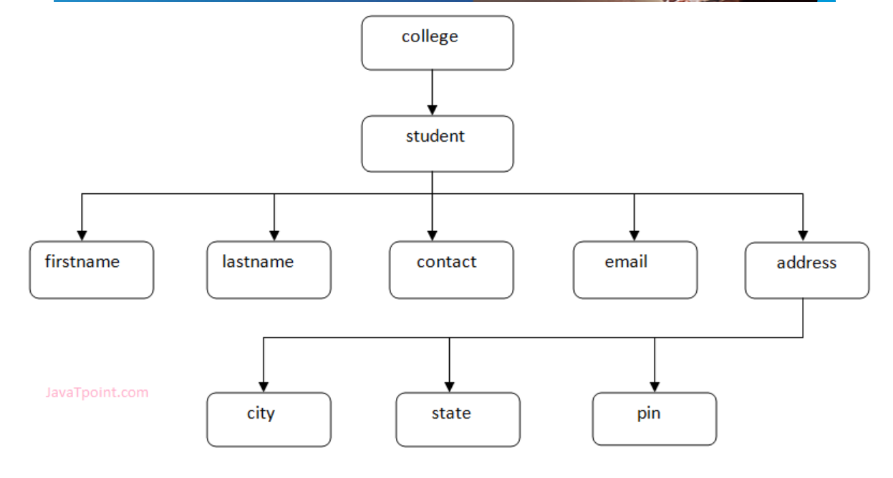
XML Tree

Slide 13
<?xml version="1.0"?>
<college>
<student>
<firstname>Tamanna</firstname>
<lastname>Bhatia</lastname>
<contact>09990449935</contact>
<email>tammanabhatia@abc.com</email>
<address>
<city>Ghaziabad</city>
<state>Uttar Pradesh</state>
<pin>201007</pin>
</address>
</student>
</college>

Slide 14
XML Example
<?xml version="1.0" encoding="UTF-8"?> <note> <to>Tove</to> <from>Jani</from> <heading>Reminder</heading> <body>Don't forget me this weekend!</body> </note>

Slide 15
XML Attributes
XML elements can have attributes.
By the use of attributes we can add the information about the element.
XML attributes enhance the properties of the elements.
<book publisher="Tata McGraw Hill"></book>

Slide 16
Difference between attribute and sub-element
In the context of documents, attributes are part of markup, while sub elements are part of the basic document contents.
In the context of data representation, the difference is unclear and may be confusing.
Same information can be represented in two ways:
<book publisher="Tata McGraw Hill"> </book> or
<book>
<publisher> Tata McGraw Hill </publisher>
</book>

Slide 17
Avoid XML attributes
Attributes cannot contain multiple values but child elements can have multiple values.
Attributes cannot contain tree structure but child element can.
Attributes are not easily expandable. If you want to change in attribute's vales in future, it may be complicated.
Attributes cannot describe structure but child elements can.
Attributes are more difficult to be manipulated by program code.

Slide 18
Rules for Element
All XML Elements Must Have a Closing Tag
XML Tags are Case Sensitive
<message>This is correct</message>
XML Elements Must be Properly Nested
<b><i>This text is bold and italic</b></i>
XML Attribute Values Must Always be Quoted
<note date="12/11/2007">
Entity References
<message>salary < 1000</message> //Error
<message>salary &lt; 1000</message>

Slide 19
Rules for well formed XML
It must begin with the XML declaration.
It must have one unique root element.
All start tags of XML documents must match end tags.
XML tags are case sensitive.
All elements must be closed.
All elements must be properly nested.
All attributes values must be quoted.
XML entities must be used for special characters.

Slide 20
XML Naming Rules
Element names are case-sensitive
Element names must start with a letter or underscore
Element names cannot start with the letters xml (or XML, or Xml, etc)
Element names can contain letters, digits, hyphens, underscores, and periods
Element names cannot contain spaces

Slide 21
XML DTD
It defines the legal building blocks of an XML document.
It is used to define document structure with a list of legal elements and attributes.

Slide 22
Valid and well-formed XML document with DTD
employee.dtd
<!ELEMENT employee (firstname,lastname,email)>
<!ELEMENT firstname (#PCDATA)>
<!ELEMENT lastname (#PCDATA)>
<!ELEMENT email (#PCDATA)>
<?xml version="1.0"?>
<!DOCTYPE employee SYSTEM "employee.dtd">
<employee>
<firstname>vimal</firstname>
<lastname>jaiswal</lastname>
<email>vimal@javatpoint.com</email>
</employee>

Slide 23
XML DTD with entity declaration
An entity has three parts:
An ampersand (&)
An entity name
A semicolon (;)
Syntax:
<!ENTITY entity-name "entity-value">
<?xml version="1.0" standalone="yes" ?>
<!DOCTYPE author [
<!ELEMENT author (#PCDATA)>
<!ENTITY sj "Sonoo Jaiswal">
]>
<author>&sj;</author>

Slide 24
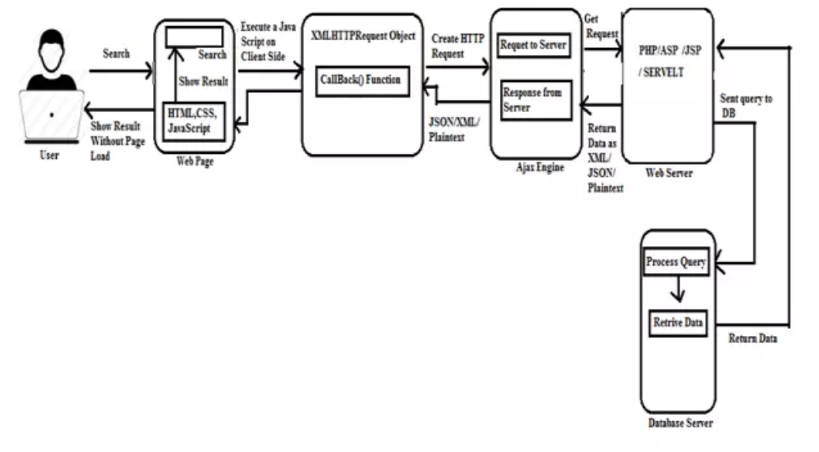

Slide 25
XML DOM
The XML DOM defines a standard way for accessing and manipulating XML documents.
It presents an XML document as a tree-structure.
The XML DOM is a standard for how to get, change, add, and delete XML elements.

Slide 26
JSON
Javascript Object Notation

Slide 27
XML JSON
<employees> <employee> <firstName>John</firstName> <lastName>Doe</lastName> </employee> <employee> <firstName>Anna</firstName> <lastName>Smith</lastName> </employee> <employee> <firstName>Peter</firstName> <lastName>Jones</lastName> </employee> </employees>
{"employees":[ { "firstName":"John", "lastName":"Doe" }, { "firstName":"Anna", "lastName":"Smith" }, { "firstName":"Peter", "lastName":"Jones" } ]}

Slide 28
Why JSON?
JSON doesn't use end tag
JSON is shorter
JSON is quicker to read and write
JSON can use arrays

Slide 29
JSON
JSON is a syntax for storing and exchanging data.
JSON is text, written with JavaScript object notation.
When exchanging data between a browser and a server, the data can only be text.
JSON is text, and we can convert any JavaScript object into JSON, and send JSON to the server.
We can also convert any JSON received from the server into JavaScript objects.
This way we can work with the data as JavaScript objects, with no complicated parsing and translations.

Slide 30
Uses of JSON
It is used while writing JavaScript based applications that includes browser extensions and websites.
JSON format is used for serializing and transmitting structured data over network connection.
It is primarily used to transmit data between a server and web applications.
Web services and APIs use JSON format to provide public data.
It can be used with modern programming languages.

Slide 31
JSON Syntax Rules
{
“book": [
{
"id": "01",
"language": "Java",
"edition": "third",
"author": "Herbert Schildt"
},
{
"id": "07",
"language": "C++",
"edition": "second",
"author": "E.Balagurusamy" }
]
}
Data is represented in name/value pairs.
Curly braces hold objects and each name is followed by ':'(colon), the name/value pairs are separated by , (comma).
Square brackets hold arrays and values are separated by ,(comma).

Slide 32
JSON Values
a string
a number
an object (JSON object)
an array
a boolean
Null
In JavaScript values can be all of the above, plus any other valid JavaScript expression, including:
a function
a date
undefined

Slide 33
Creating Simple Objects
var JSONObj = {}; // Empty Object
var JSONObj = new Object(); // Create new object
Var JSONObj= {“bookname” : “V”, “price” : 500};

Slide 34
JSON - Schema
JSON Schema is a specification for JSON based format for defining the structure of JSON data.
Describes your existing data format.
Clear, human- and machine-readable documentation.
Complete structural validation, useful for automated testing.
Complete structural validation, validating client-submitted data.

Slide 35
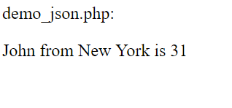
<!DOCTYPE html>
<html>
<body>
<h2>Convert a JavaScript object into a JSON string, and send it to the server.</h2>
<script>
var myObj = { name: "John", age: 31, city: "New York" };
var myJSON = JSON.stringify(myObj);
window.location = "demo_json.php?x=" + myJSON;
</script>
</body>
</html>

Slide 36
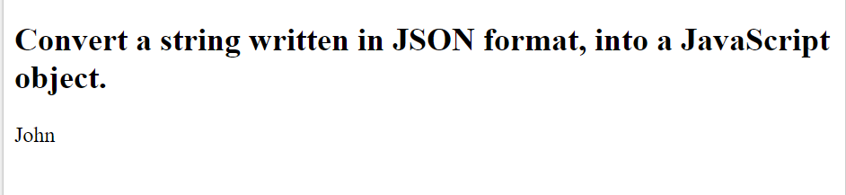
<!DOCTYPE html>
<html>
<body>
<h2>Convert a string written in JSON format, into a JavaScript object.</h2>
<p id="demo"></p>
<script>
var myJSON = '{"name":"John", "age":31, "city":"New York"}';
var myObj = JSON.parse(myJSON);
document.getElementById("demo").innerHTML = myObj.name;
</script>
</body>
</html>

Slide 37
JSON vs XML
{"employees":[ { "firstName":"John", "lastName":"Doe" }, { "firstName":"Anna", "lastName":"Smith" }, { "firstName":"Peter", "lastName":"Jones" } ]}
<employees> <employee> <firstName>John</firstName> <lastName>Doe</lastName> </employee> <employee> <firstName>Anna</firstName> <lastName>Smith</lastName> </employee> <employee> <firstName>Peter</firstName> <lastName>Jones</lastName> </employee> </employees>

